Slide 1
Community Choice Aggregation (CCA)
2023
Digital Image. Pico Rivera Innovative Municipal Energy
www.poweredbyprime.org

Slide 2
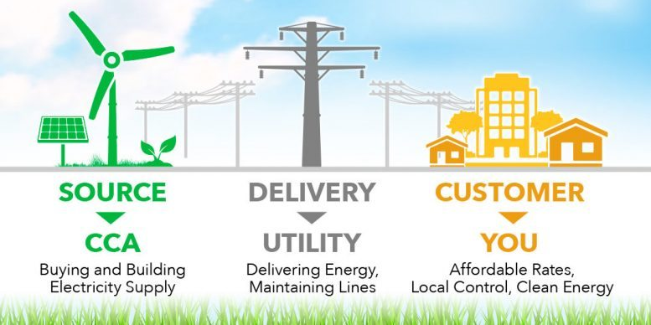
Community Choice Aggregation (CCA)
Digital Image. Technocracy. https://www.technocracy.news/wp-content/uploads/2017/04/CCA-infograph-777x437.jpg

Slide 3
Community Benefits of CCAs¹
Alternative revenue streams to local government
Control over local energy rates and future
Cost savings to consumers
Encourage local job creation
Promote greater renewable energy use
A new, positive touchpoint with community
1. California Choice energy Authority website. https://californiachoiceenergyauthority.com/benefits-of-cca/

Slide 4
Low Income Benefits of CCAs
CAL CCA states that CCA’s provide more affordable energy (no rate discounts for particular customer class)
MCE receives Energy Assistance Savings Program funds (funded by all ratepayers) and is in the process of weatherizing homes

Slide 5
CCA Risks and Challenges
Cost Shifting and Impact on Existing Customers
CCAs typically rely on contracts and market purchase for power supply
CCAs do not have broad access to bank facilities and capital markets
Maintaining competitive rates and cost savings for customers
Local electricity market and regulatory conditions can create risks
Balancing local autonomy and regional cooperation
Meeting demand for local renewable energy
Customer opt out policies vary by CCA and state
Can make it difficult to maintain stable customer base
Is there Customer Choice?
Resource adequacy: ability of generation resources on a grid to supply electricity during peak events
Notes:
Sources: https://www.fitchratings.com/research/us-public-finance/community-choice-aggregator-risks-highlighted-by-bankruptcy-02-06-2021
https://www.sandiegouniontribune.com/business/story/2021-06-02/riverside-county-community-choice-energy-program-becomes-first-in-california-to-file-for-bankruptcy
O’Shaughnessy, Eric, Jenny Heeter, Julien Gattaciecca, Jenny Sauer, Kelly Trumbull, and Emily Chen. 2019. Community Choice Aggregation: Challenges, Opportunities, and Impacts on Renewable Energy Markets. Golden, CO: National Renewable Energy Laboratory. NREL/TP-6A20-72195. https://www.nrel.gov/docs/fy19osti/72195.pdf.

Slide 6
Are CCAs really a choice?
Automatically enrolled, must opt out
Customers don’t know about new provider (Customer Awareness)
Example: San Diego Community Power and SDG&E
Notes:
Sources: https://voiceofsandiego.org/2022/04/03/is-community-choice-energy-really-a-choice/
https://www.greentechmedia.com/articles/read/california-to-hike-fees-on-community-choice-aggregators-direct-access

Slide 7
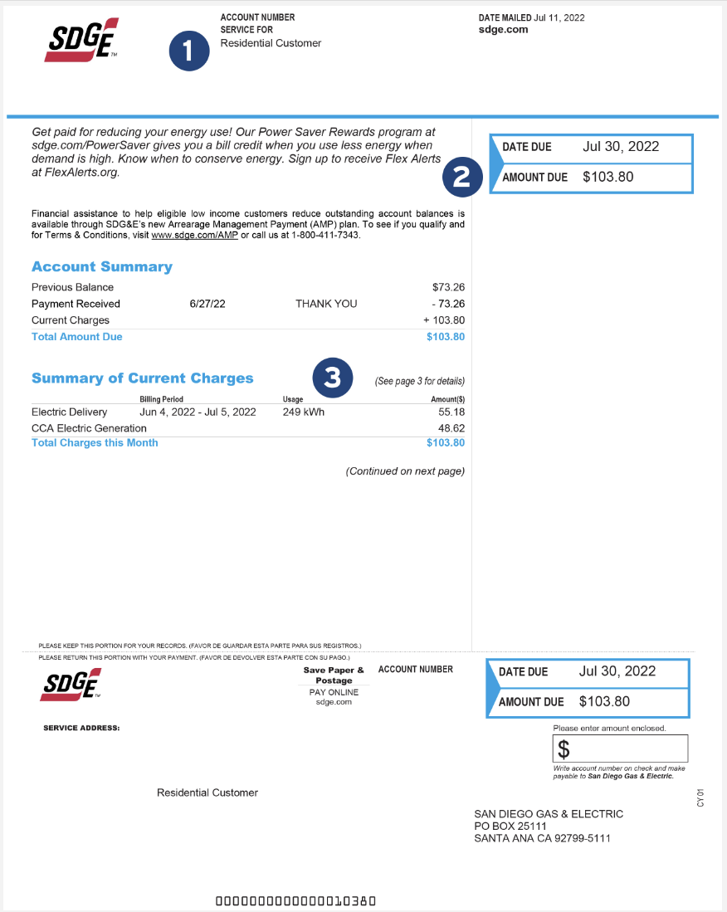
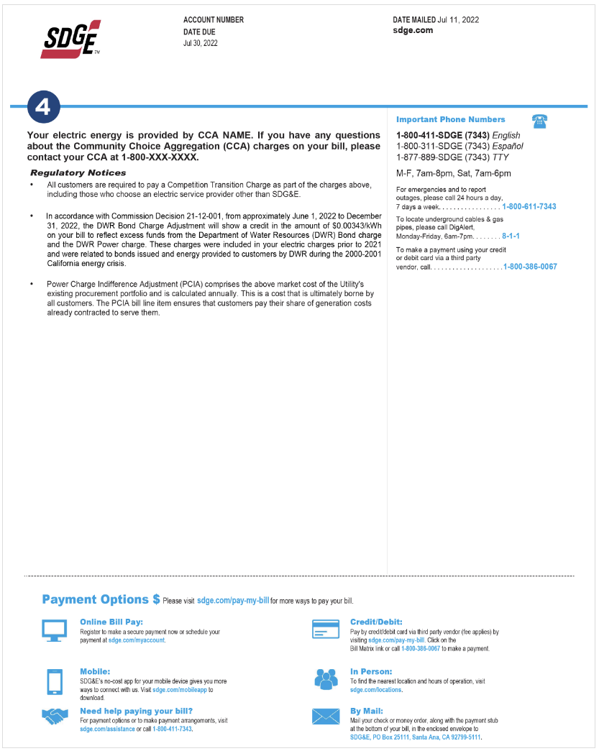
Customer Awareness
Most customers unaware that any change has occurred after CCA implementation despite CCA mail notices and community outreach campaigns
Customers continue to get bill from their local utility
Notes:
4. Your Community Choice Provider name and contact information is listed here.
Sources: O’Shaughnessy, Eric, Jenny Heeter, Julien Gattaciecca, Jenny Sauer, Kelly Trumbull, and Emily Chen. 2019. Community Choice Aggregation: Challenges, Opportunities, and Impacts on Renewable Energy Markets. Golden, CO: National Renewable Energy Laboratory. NREL/TP-6A20-72195. https://www.nrel.gov/docs/fy19osti/72195.pdf.

Slide 8
Barriers to Sharing of Information
CODE OF CONDUCT
- Define basic concepts relevant to electric utility actions with respect to CCAs, including “marketing,” “lobbying,” “promotional or political advertising,” and “competitively sensitive information.”
- Require preparation and distribution of a neutral comparison of the tariffs of the utility and any CCA within that utility’s service territory.
- Require a separation between a utility’s marketing division and its other functional divisions, such as billing and customer service, for any utility that intends to market against actual or potential CCAs within its territory.
- Require utilities to provide access to information to CCAs on the same terms as it does for its independent marketing division.
- Prohibit utilities from speaking on behalf of a CCA or making any untrue or misleading statement about a CCA’s service. Require modified draft rules to apply tariff provisions in the same manner to similarly situated entities.
- Institute reporting and other documentation requirements for utilities related to their interactions with CCAs and with their independent marketing divisions.
- Require periodic audits of utilities to assess their compliance with the Code of Conduct.
- Establish a complaint procedure for use by CCAs in the event that they believe a utility is not meeting its obligations under this Code.
Most Pertinent:
7) An electric corporation shall provide access to utility information, rates and services to community choice aggregators on the same terms as it does for its independent marketing division.
9) An electrical corporation shall refrain from: 1) speaking on behalf of CCA a program; 2) giving any appearance of speaking on behalf of any CCA program; or 3) making any statement relating to the community choice aggregator’s rates or terms and conditions of service that is untrue or misleading, and that is known, or that, by the exercise of reasonable care, should be known, to be untrue or misleading.

Slide 9
Western Community Energy
Served 6 towns in Riverside County
First CCA in CA to file for bankruptcy
Launched during COVID-19 pandemic in April 2020
Did not have:
capital
financial reserves, or
adequately foresee power needs and energy costs
Inadequate risk management, unexpected spikes in demand and compliance with state mandates can hinder a CCA’s ability to manage costs and provide competitively priced power supply
Notes:
Sources: https://www.fitchratings.com/research/us-public-finance/community-choice-aggregator-risks-highlighted-by-bankruptcy-02-06-2021
https://www.sandiegouniontribune.com/business/story/2021-06-02/riverside-county-community-choice-energy-program-becomes-first-in-california-to-file-for-bankruptcy

Slide 10
Issues To Watch- CCA Expansion
Educating Consumers- Ensuring all customers have adequate information
Serving all customers- impact on low income
Meeting renewable goals- compliance of retail sellers
Generating living wage jobs- local jobs/local generation
Maintaining resource adequacy rules- oversight of procurement
Meeting supplier diversity goals- parody
Promoting consumer protections- parody
Access to capital- lack of credit history
Cost shifting to customers- increased costs

Slide 11
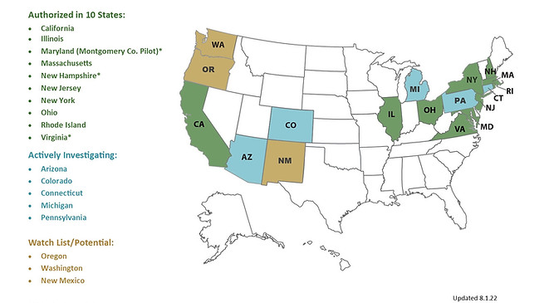
CCAs at a National Level
Source: LEAN Energy August 2022: http://leanenergyus.org/cca-by-state/

Slide 12
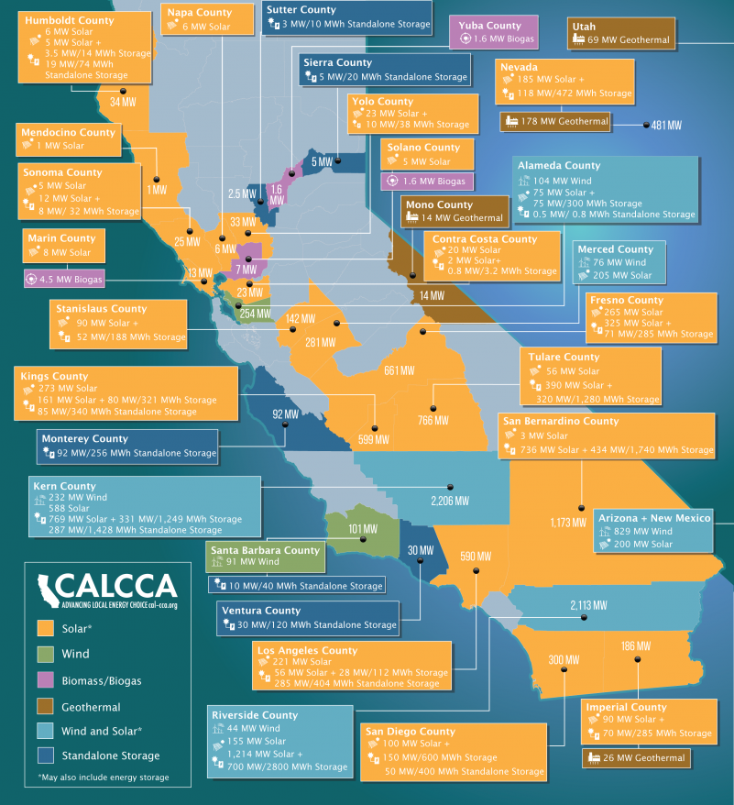
California CCAs²
Apple Valley Choice Energy
Central Coast Community Energy
Clean Energy Alliance
(cities of Carlsbad, Del Mar and Solana Beach; planned expansion April 2023)
Clean Power Alliance
(Los Angeles and Ventura counties)
CleanPowerSF
Desert Community Energy
East Bay Community Energy
Energy for Palmdale’s Independent Choice (EPIC)
King City Community Power
Lancaster Choice Energy
MCE Clean Energy
(Marin, Napa, Contra Costa and Solano counties)
Orange County Power Authority
Peninsula Clean Energy
(San Mateo County and Los Banos)
Pico Rivera Innovative Municipal Energy
Pomona Choice Energy
Pioneer Community Energy
(includes Placer and El Dorado counties)
Rancho Mirage Energy Authority
Redwood Coast Energy Authority
San Diego Community Power
(planned expansion April 2023)
San Jacinto Power
San Jose Clean Energy
Santa Barbara Clean Energy
Silicon Valley Clean Energy
Sonoma Clean Power
Valley Clean Energy
(includes Yolo County)
2. CalCCA. https://cal-cca.org/cca-impact/

Slide 13
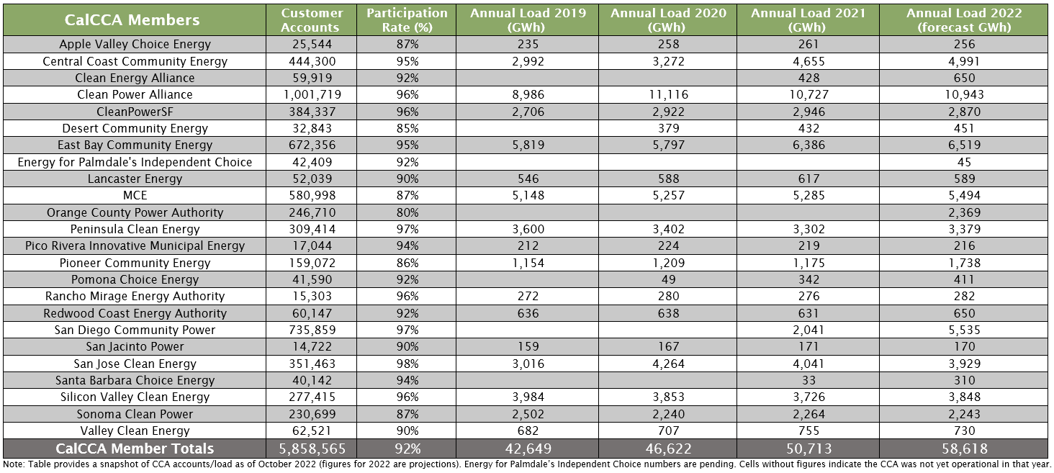
California CCAs
2. CalCCA. https://cal-cca.org/cca-impact/

Slide 14
California CCAs
California CCAs have contracted for over 11,000 megawatts (MW) of new clean generation capacity through long-term power purchase agreements with terms of 10 years or longer. ²
2. CalCCA. https://cal-cca.org/cca-impact/

Slide 15
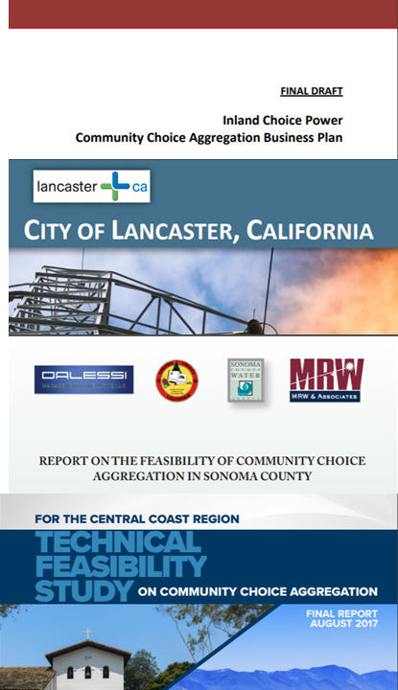
Requirements of Feasibility Studies
Achieve nominal electricity cost savings.
Increase renewable energy utilization.
Obtain control over electric generation costs to provide a higher level of rate stability for local residents and businesses.
The technical / feasibility study identifies pertinent specifications and requirements associated with the prospective CCA Program.
Include the projected impacts of various clean energy and GHG reduction scenarios.
Economic / employment component helps determine the broad effects on economy and labor in the County.
NO REQUIREMENT ON LOW INCOME IMPACT

Slide 16
Completion of Feasibility Studies
vs. Low Income Assessments
 | FEASIBILITY & IMPLEMENTATION STUDY? | LOW INCOME ASSESSMENT?
1. Marin Clean Energy
2. Sonoma Clean Power
3. Lancaster Choice Energy
4. CleanPowerSF
5. Peninsula Clean Energy
6. Silicon Valley Clean Energy
7. Clean Power Alliance (LA County)
8. Desert Community Energy
9. Apple Valley Clean Energy
10. Monterey Bay Community Power
11. Pico Rivera Innovative Municipal Energy
12. Redwood Coast Clean Energy
13. San Jacinto Power
No
No
No
No
No
No
No
No
No
No
No
No
No
Comparison between the number of CCAs that developed a feasibility study and included a Low Income Assessment.

Slide 17
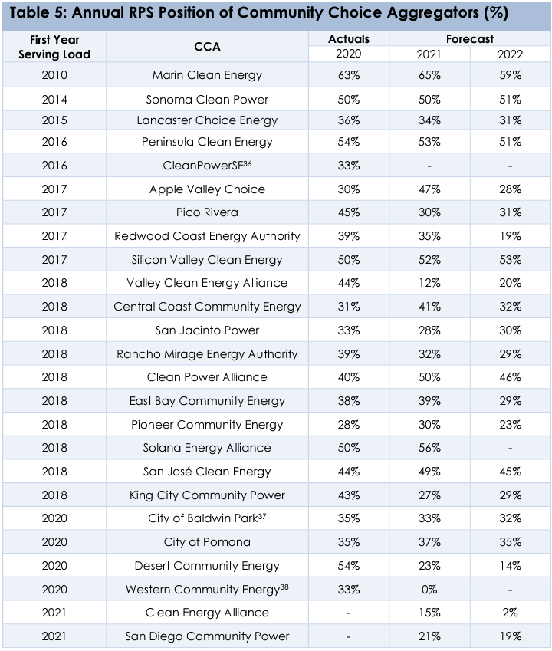
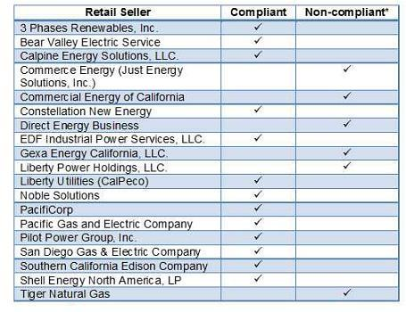
California RPS & CCAs
The Renewables Portfolio Standard (RPS) Program requires all retail energy sellers to procure 100% renewable energy by 2045.
Data Source: CCA Draft RPS Procurement Plans (July 2021), CCA RPS Compliance Reports (August 2021) , California Senate (2019)
Notes:
Data Source: CCA Draft RPS Procurement Plans (July 2021), CCA RPS Compliance Reports (August 2021)

Slide 18
Workforce Development
RichmondBUILD
A public private partnership focused on developing talent and skill in the high growth, high wage construction and renewable energy fields.
RichmondBUILD participants complete the core Carpentry Pre-Apprenticeship track, and then choose from the following electives:
Extended Carpentry
Hazardous Waste Removal
Solar Energy
Energy Efficiency
Electrical Wiring & Theory
RichmondBUILD students complete a solar installation project.
http://www.ci.richmond.ca.us/1243/RichmondBUILD

Slide 19
Workforce Development
MCE Solar One
One of Bay Area’s largest public-private solar partnership
Provides 10.5 MW, 3,900 households annually in Richmond
Supported 341 jobs
Maximized local economic benefits by requiring 50% local resident workforce
Partnered with RichmondBUILD and local contractors
Notes:
Source:https://www.mcecleanenergy.org/local-projects/#SolarOne

Slide 20
Workforce Development
Antelope Expansion 2
SPower and MCE Project
Largest Solar Project Completed to Date with Community Choice Aggregator
Provides 120 MW
Worked with Southern CA Trade Unions

Slide 21
Low Income Assessment

Slide 22
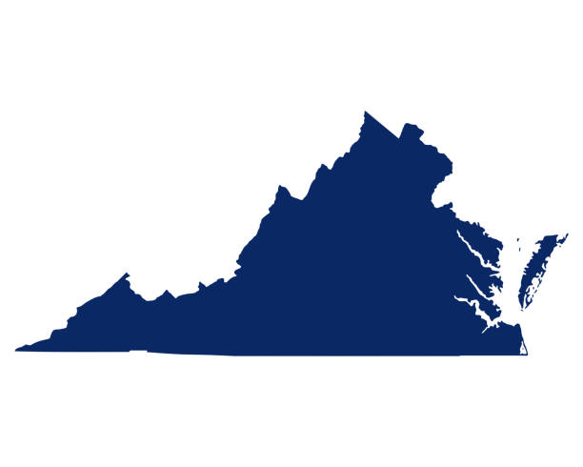
CCAs Virginia
CCA Feasibility Study
CCAs, called municipal aggregation in Virginia, found to be financially feasible
Risks and potential impacts to financial feasibility
Maintaining competitive customer rates
Maintaining positive net revenues
Exit fee costs that the utility passes onto all customers
Market supply of renewable power
Availability and cost of financing
Legislative and regulatory actions
Many governance, regulatory and technical tasks still need to be resolved before a municipal aggregation business model can become functional
Source :https://www.virginiacleanenergy.org/cca-data-centers-policy-study.html
Notes:
Next Steps:
There are many governance, regulatory and technical tasks that need to be resolved before a municipal
aggregation business model can become functional. A summary of these tasks follow:
◻ Governance Tasks
• Choose a governance structure such as the enterprise or service district models.
• Determine which local governmental units should participate such as County only, County and
towns within the County or seek local governments outside of County.
• Develop a strawman governance document.
◻ Regulatory Tasks
• The SCC should be contacted to appraise them of the County’s desires and intentions, and to
solicit SCC staff feedback on the merits of the County pursuing the municipal aggregation business
model.
• The SCC staff should also be asked about the regulatory status of exit fees in the Commonwealth
and any technical input on this Study’s input assumptions. Also discuss the opt-in/opt-out
assumptions and licensing requirements.
• Determine what customer notice requirements will be needed.
◻ Technical Tasks
• Confirm that Dominion will continue to read all meters, prepare all bills, and collect revenues then
rebate the market aggregator’s portion to the market aggregator.
• Develop a timeline for key activities in forming a municipal aggregation business model that
includes the tasks noted above as well as staffing requirements.
Sources :https://www.virginiacleanenergy.org/cca-data-centers-policy-study.html

Slide 23
CCAs Virginia
1999
​§ 56-589 established municipal and state aggregation in Virginia
Counties, cities, municipalities and other political subdivisions may establish a municipal aggregation for the electricity service.
2018
January 2018, HB 1590 Utility regulation; community choice aggregation was introduced and voted negatively 6-2
June 2018, Virginia Clean Energy, a nonprofit, was formed with the mission to accelerate the expansion of, and competitive success of, clean and renewable energy via Community Choice Aggregation (CCA) in Virginia.
2021
Loudoun County Board of Supervisors commissioned a CCA Feasibility Study
2022
CCA Feasibility Study Completed
Students from the UCLA Luskin School of Public Affairs have researched the impact of CCA on decarbonizing data centers in Loudoun County.
County is also considering Power Purchase Agreements (PPAs) and a Green Bank
Source :https://www.virginiacleanenergy.org/cca-data-centers-policy-study.html
Notes:
Sources :https://www.virginiacleanenergy.org/cca-data-centers-policy-study.html

Slide 24
CCAs in New York
Issues
Joule Community Power
Ongoing lawsuits between this CCA, its client towns and electricity providers over breaches of contract
Town of Brighton, one of Joule’s municipal clients, and Joule are fighting with an electricity provider, Icon Energy.
Icon stopped providing power to that town’s residents as it was contractually obligated to do.
Residents have lost $1 million since the company stopped providing electricity six months ago.
Hudson Valley Community Power, partnership between Joule and Hudson Valley Energy
In July 2022, customers of this CCA returned to Central Hudson electricity service
This came after Columbia Utilities was declared default one week earlier when the company failed to comply with the requirements of the New York Independent System Operator (NYISO), which is responsible for operating the state’s bulk electricity grid.
Notes:
Written Jan 18th, 2023: residents of Brighton have saved $1.2 million total on electricity under the contract with Icon, but have subsequently lost $1 million since the company stopped providing electricity six months ago.
-HVCP is a CCA partnership between Joule Community Power, which serves as the program administrator; and Hudson Valley Energy, the local program manager.
Sources: https://www.northcountrynow.com/news/potsdam-town-supervisor-concerned-over-community-choice-aggregation-company-lawsuits-0333531
https://hudsonvalleyone.com/2022/08/01/cca-program-comes-to-a-premature-end-for-now/

Slide 25
CCAs in New York
Public Service Commission’s New Changes 2023
All customers will be charged the same product price, regardless of enrollment date.
The price-to-compare information for the CCA market will be made consistent across all CCAs and utilities
Fixed-rate supply products will be limited to 105% of the 12-month trailing average utility supply rates, and variable-rate products must offer a guaranteed savings, while renewable products will not have a price cap because of limited ability to determine a reasonable price.
Department staff will prepare a proposal for a statewide solar-for-all program
Any distribution utility with tariffed provisions providing for CCAs in its territory must add a dedicated CCA page to its website.
Standardized templates and guidelines for CCA administrator compliance filings will be created.
The CCA administrator, utility and ESCO and must notify each other and DPS staff within 48 hours of learning of a billing error that affects 50 or more customers.
CCA administrators must maintain a list of customers that have opted out of the CCA to prevent the customers from receiving future opt-out notifications.
Notes:
Full detailed list:
All customers in a given CCA program will be charged the same product price, regardless of enrollment date.
The price-to-compare information for the CCA market will be made consistent across all CCAs and utilities by using the 12-month trailing average of the utility rate plus a merchant function charge and any defined adder that applies to utility supply customers but not ESCO customers.
Fixed-rate supply products will be limited to 105% of the 12-month trailing average utility supply rates, and variable-rate products must offer a guaranteed savings, while renewable products will not have a price cap because of limited ability to determine a reasonable price.
Department staff will prepare a proposal for a statewide solar-for-all program like the one created by National Grid in its upstate New York service area.
Any distribution utility with tariffed provisions providing for CCAs in its territory must add a dedicated CCA page to its website.
Standardized templates and guidelines for CCA administrator compliance filings will be created.
The CCA administrator, utility and ESCO and must notify each other and DPS staff within 48 hours of learning of a billing error that affects 50 or more customers.
CCA administrators must maintain a list of customers that have opted out of the CCA to prevent the customers from receiving future opt-out notifications.
Source: https://www.rtoinsider.com/articles/31478-ny-changes-community-choice-aggregation-rules

Slide 26
CCEs in Colorado
House Bill 21-1269
Signed June 25, 2021, directed the Colorado Public Utilities Commission to open an investigatory proceeding into CCE authorization in Colorado, including completion of a report to the legislature summarizing the investigation findings by December 15, 2022.
Proceeding No. 221-0027E
January 2022, PUC issued Decision No. C22-0032, which formally opened Proceeding No. 22I-0027E, The Study of Community Choice in Wholesale Electric Supply
Includes 38 questions about potential implications of CCE authorization in Colorado.
Questions on a range of issues: regulatory authority, resource adequacy and reliability, affordability, customer programs, renewable resources and greenhouse gas emissions, consumer protections, and broader wholesale market considerations.
Source: Proceeding No. 221-0027E: In the Matter of the Commission’s Implementation of § 40-4-120, C.R.S., the Study of Community Choice in Wholesale Electric Supply

Slide 27
Colorado
Affordability
Opportunities and Benefits
CCEs may be able to offer electricity at lower costs than the incumbent IOU.
Competition between CCE authorities and IOUs could drive both entities to reduce costs.
CCEs may be able to offer bill assistance programs that are more effective than similar programs offered by the IOUs.
Risks and Drawbacks
Exit fees/transition fees
CCEs may end up with higher electricity costs than the incumbent IOU
CCEs could choose to opt all their customers, including low-income customers, into purchasing power that is more renewable, but also more expensive.
If CCEs are enabled, the legislature or the Commission would need to establish clear regulations for how bill assistance programs will work, with attention to protecting customers with lower incomes.
If CCEs are allowed to offer their own bill assistance programs, those programs may be less effective than the programs offered by the incumbent investor-owned utilities.
Source: Proceeding No. 221-0027E: In the Matter of the Commission’s Implementation of § 40-4-120, C.R.S., the Study of Community Choice in Wholesale Electric Supply
Notes:
From Proceeding No. 221-0027E

Slide 28
Colorado
Impact on Low-income Households
Commission Findings
“The Commission would need to retain regulatory oversight over the CCE authority formation and opt-out processes with respect to the impacts on customers with lower incomes and on bill assistance programs.”
“The Commission should initiate a proceeding to develop clear guidance and rules for how energy assistance programs should be funded and operated, including how revenues should be collected, and with a focus on ensuring that CCE enablement does not ultimately result in worse outcomes for customers with lower incomes.”
Source: Proceeding No. 221-0027E: In the Matter of the Commission’s Implementation of § 40-4-120, C.R.S., the Study of Community Choice in Wholesale Electric Supply
Notes:
Comments from Proceeding No. 221-0027E

Slide 29
CCAs in New Mexico
Local Choice Energy Act, SB-165 introduced in the current legislative session
Bill would authorize city, county or Indigenous governments to purchase or generate renewable energy for sale to constituents, intending to expand the use of low-carbon forms of electricity in New Mexico.
Local electricity customers will be allowed to opt out of the program, and the bill language specifically bars municipal governments from requiring they opt in.
Notes:
Sources :https://www.abqjournal.com/2568780/local-choice-energy-act-allows-cities-to-control-energy-generation.html
https://www.currentargus.com/story/news/2023/01/24/local-control-of-renewable-energy-pushed-in-new-mexico-senate-bill/69826541007/

Slide 30
CCEs in Maryland
In 2021 Maryland passed House Bill 768, which allowed a Community Choice Energy (CCE) pilot program in Montgomery County
Established a Community Choice Work Group and will develop an implementation plan
CCE set to launch in December 2023
No opt-out costs for customers

Slide 31
Recommendations
Assess long term viability of CCA’s based on individual state regulatory structure, customer base, renewable goals, and adequate oversight on procurement.
Ensure CCAs include low-income assessments in their economic feasibility plans.
Revisit opt-in model. Have and improved Consumer Education process. Have a clear process for outreach to low-income individuals and families.
Allow information to be gathered/shared by incumbent utilities.
Clearly articulate low-income services in CCA areas.
Make renewable explicit as part of forming a CCA and not just the RPS. Ensure oversight and sanctions are in place to ensure compliance.
States should study and consider allowing CCAs to form in non-IOU territories.

Slide 32
Thank You
Jose Hernandez
213.434.0824
jhernandez@ideatecal.com
www.ideatecal.com

Slide 33
Research & Resources
Marin Clean Energy:
Light Green – Default service program
Deep Green – Optional 100% renewable energy program
Deep Green Champion Program – Local businesses, non-profits, and public agencies that choose 100% renewable energy.
Local Sol Program – Community Solar, 100% Local Solar Energy
Net Energy Metering (NEM) Program – – Bill credit for clean power fed to the grid
Smart Charge Electric Vehicle Pilot Program – An EV pilot program that adapts the times when your car is charging in order to help relieve grid congestion and maximize renewable energy capacity in California.
Energy Efficiency Program – Rebates, technical assistance and financing for energy efficiency
Feed-in Tariff Program – Standard payment and terms for mid-scale projects (up to one megawatt capacity)
Sonoma Clean Power:
CleanStart – Basic default service
EverGreen – Optional 100% renewable energy
NetGreen – Bill credit for clean power fed to the grid
ProFIT – Standard payment and terms for mid-scale projects (up to one megawatt capacity)
Drive EverGreen – A program aimed at fostering electric vehicle adoption
Energize – Demand response
Lancaster Choice Energy:
Clear Choice – Basic, default service
Smart Choice – Optional 100% renewable energy
Personal Choice Program – Bill credit for clean power fed to the grid
Smart Choice Champions – Local businesses, non-profits, and government agencies that choose to buy 100% renewable energy

Slide 34
Research & Resources
CleanPowerSF:
Green – Basic, default service
SuperGreen – Optional 100% renewable energy
Solar Net Energy Metering – Bill credit for clean power fed to the grid
Peninsula Clean Energy:
EcoPlus – Basic, default service
Eco100 – Optional 100% renewable energy
Solar Net-metering – Bill credit for clean power fed to the grid
Silicon Valley Clean Energy:
GreenStart – Basic, default service
GreenPrime – 100% carbon free, 100% renewable
Solar Rooftop – net metering program
Clean Power Alliance
Desert Community Energy

